Slide 1


Clinical Toxidromes
Tanya L. Claiborne, Pharm.D., BCEMP
Clinical Pharmacy Services Manager
Riverside Regional Medical Center

Slide 2
Objectives
Detail history & epidemiology of toxin abuse
Determine signs & symptoms of medication misadventures
Demonstrate how to obtain an accurate medication history
Define toxidromes and key antidotes
Differentiate deadly ingestions
Discuss emerging substances with abuse potential

Slide 3
History of Drug Laws
No control <1900s
Pure Food and Drug Act
1906
(Roosevelt)
International Opium
Convention
1912
Harrison Narcotics Tax Act
1914
Ban on sale of Heroin 1924
Controlled Substances Act
1970 (Nixon)
Federal Controlled Substance Analogue Enforcement Act
1986
Secure and Responsible Drug Disposal Act
2010
Prescription Drug Monitoring Programs

Slide 4
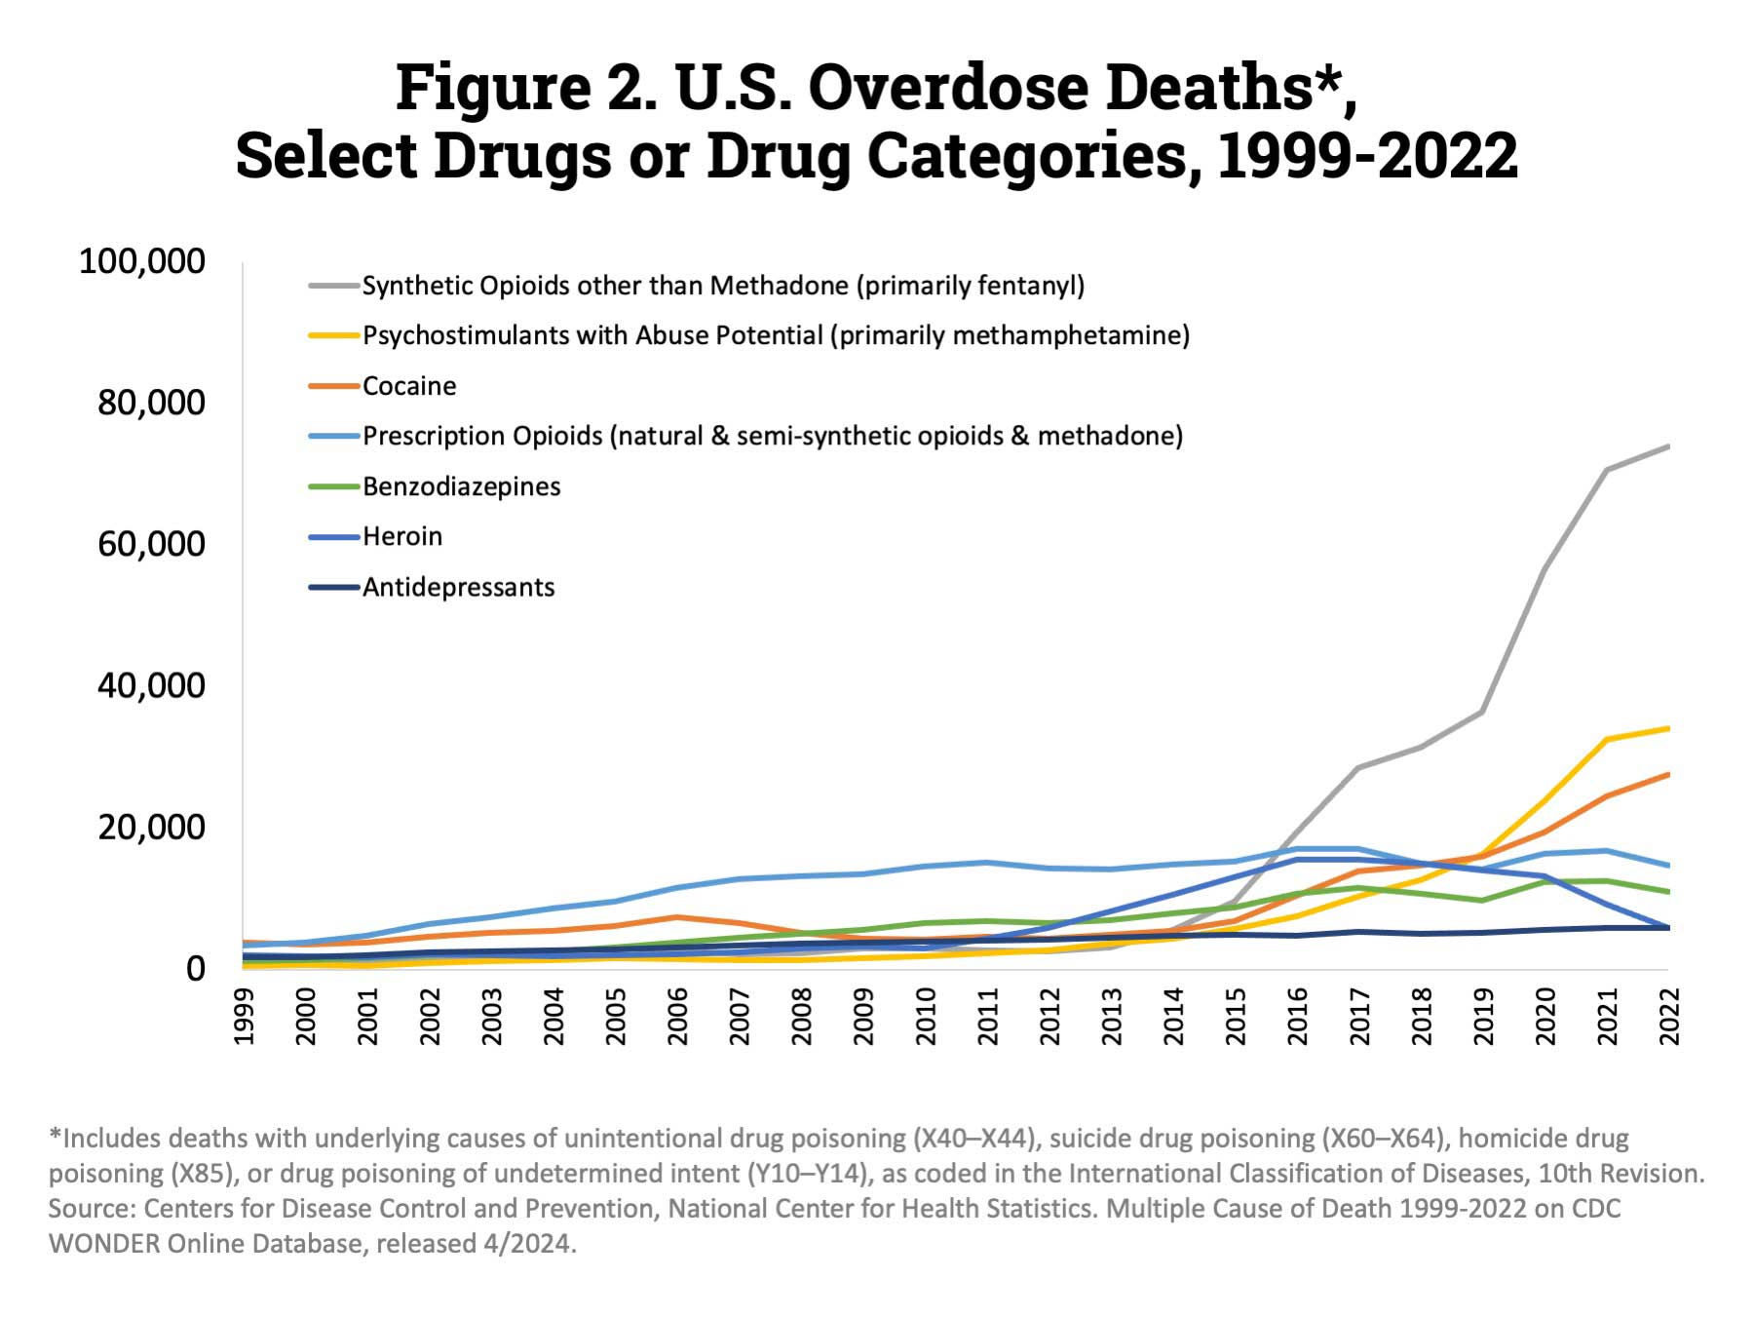
Epidemiology
Drug overdoses are the leading cause of injury death in the U.S.
Nationally: 105,007 drug overdose deaths in 2023
The age-adjusted rate of drug overdose deaths increased from 8.9 deaths per 100,000 in 2003 to 32.6 in 2022
  Decreased to 31.3 in 2023
Garnett MF, Miniño AM. Drug overdose deaths in the United States, 2003–2023. NCHS Data Brief, no 522. Hyattsville, MD: National Center for Health Statistics. 2024. DOI: https://dx.doi.org/10.15620/cdc/170565.
Drug Overdose Deaths: Facts and Figures | National Institute on Drug Abuse (NIDA)

Slide 5
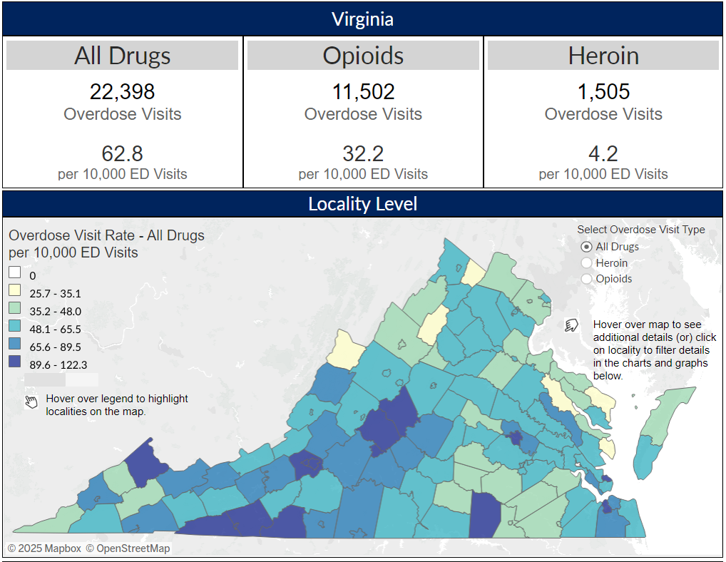
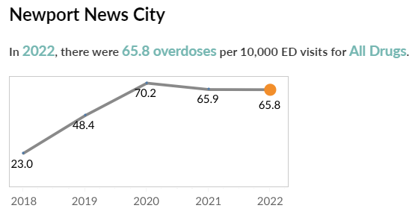
Epidemiology
EMS impact
Financial impact
  Criminal justice
  Law enforcement
  Treatment costs
  Loss of wages
  from premature death
Overdose Emergency Department Visits – Drug Overdose Data

Slide 6


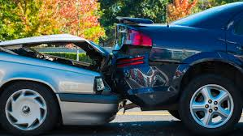
Toxic patient presentation
Specific vs. non-specific
Altered mental status
Unable to follow commands
Hallucinations
Chronic vs. acute ingestions
Complicates any presentation
High suspicion in accidents / trauma
Altered vital signs
Changes in pupils
Duration of symptoms
Withdrawal

Slide 7
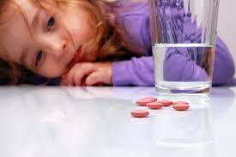
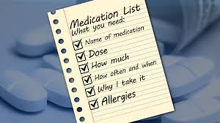
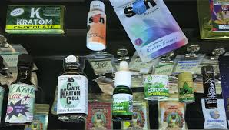
Field medication history
Anatomy of the ingestion
  What
  When
  How much
  Route or entry point
  Frequency of use
  Poly-pharmacy?
  Collect all pill bottles available
  Other pertinent circumstances
  Obtain medication list – Bring it!
  Reversal agents on scene?
  Emesis?

Slide 8
Principles of toxicology management
Stabilize
Focused history
Physical findings
Decontamination
Labs / imaging
Antidote administration
Thompson TM, Theobald J, Erickson TB. The general approach to the poisoned patient. Dis Mon. 2014; 60(11):509-24.

Slide 9

Stabilize
Primary Assessment
  ABC
  Disability (Alert, Voice, Painful, Unresponsive)
  Exposure (Temperature)
Secondary Assessment
  Signs and symptoms
  Allergies
  Medications
  Past Illnesses
  Last oral intake
  Events leading to present illness
Link MS et al. Circulation. 2015; 132:S444–S464

Slide 10
Focused History
Who is the patient?
Whose is the medication?
What is the substance?
When did the exposure occur?
Why did the exposure occur?
Infant, adolescent, facility resident, occupation, hobbies, etc.
Patient’s own medications or someone else’s?
Formulation / route
Acute vs. chronic
Suicide vs. unintentional

Slide 11
Physical findings
Toxidrome identification
Use your senses!
Vitals + glucose
Focused exam
  Neuro
  Pupils
  GI/GU
  Derm / mucous membranes
  Tone
Thompson TM, Theobald J, Erickson TB. The general approach to the poisoned patient. Dis Mon. 2014; 60(11):509-24.

Slide 12
Olfaction
Odor
  Bitter almonds
  Fruity
  Garlic
  Gasoline
  Mint
  Mothballs
  Pears
  Rotten eggs
Possible source
  Cyanide
  Ketosis (isopropyl alcohol)
  Arsenic, pesticides
  Hydrocarbons
  Methyl salicylate
  Camphor, naphthalene
  Chloral hydrate
  Hydrogen sulfide
Thompson TM, Theobald J, Erickson TB. The general approach to the poisoned patient. Dis Mon. 2014; 60(11):509-24.

Slide 13
Toxidrome
A constellation of signs and symptoms that point to a specific group of toxins according to their pharmacologic effect
Provides consistency in a known overdose and insight into creating a differential diagnosis in unknown overdose
Cholinergic / Anticholinergic
Sympathomimetic (GABAergic withdrawal)
Opioid / Opioid withdrawal
Sedative/hypnotic
NMS / Serotonin syndrome
Mofenson HC, Greensher J (1970). "The nontoxic ingestion". Pediatric Clinics of North America. 17 (3): 583–90. PMID 5491430

Slide 14
Patient Case
60 yo F presenting to the ED with CC of agitation/AMS
  ED doc recommends admission
  PE:
    (+) confusion / AMS
    HEENT: ocular clonus noted, mydriasis, diaphoretic with dry mucous membranes
    Chemistry WDL, CBC – mild leukocytosis, CPK pending
    (+) U/A, yeast
    Tox workup (UDS / Blood panel) (-)
    Temp WDL
    Hyperactive bowel sounds
  PMH:
    Depression, hypothyroidism, HTN, Bipolar I, recent ankle strain

Slide 15
Patient Case
Morning Medications:
  Synthroid 75 mcg daily
  Norvasc 10mg daily
  Quetiapine 50mg qam
  Benztropine 1mg
  MVI
PRNs:
  APAP 650mg q4h for ankle pain
  Tramadol 50mg q6h for ankle pain
Evening Medications:
  Sertraline 100mg qpm
  Quetiapine 25mg qpm
  Benztropine 1mg
Keflex, fluconazole initiated on admission for UTI

Slide 16
Toxidrome Diagnosis
Overnight she became hypertensive (BP 108-158mmHg/52-105mmHg), tremulous with clonus in LE
T 36.2-37.4⁰C, HR 77-107 bpm, RR 17-46, SpO2 92-98%
CPK returned at 693 IU/L
Toxidrome Differential
  Neuroleptic malignant syndrome (NMS)
  Catatonia
  Anticholinergic toxicity
  Malignant hyperthermia (MH)
  Serotonin Syndrome
  Sympathomimetic agent intoxication
  Thyroid storm
  Acute extrapyramidal syndromes
  Encephalitis or meningitis

Slide 17
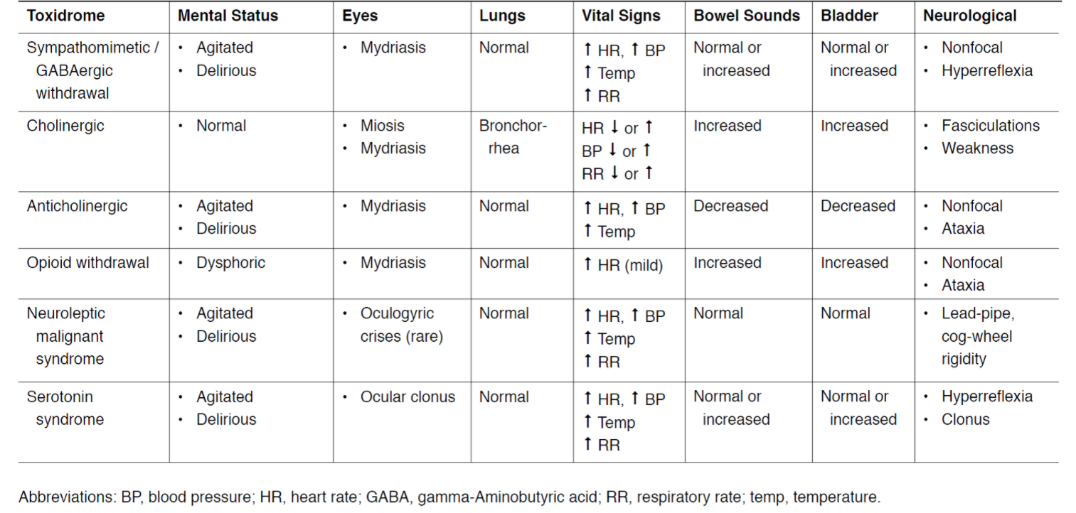

Common Toxidromes

Slide 18
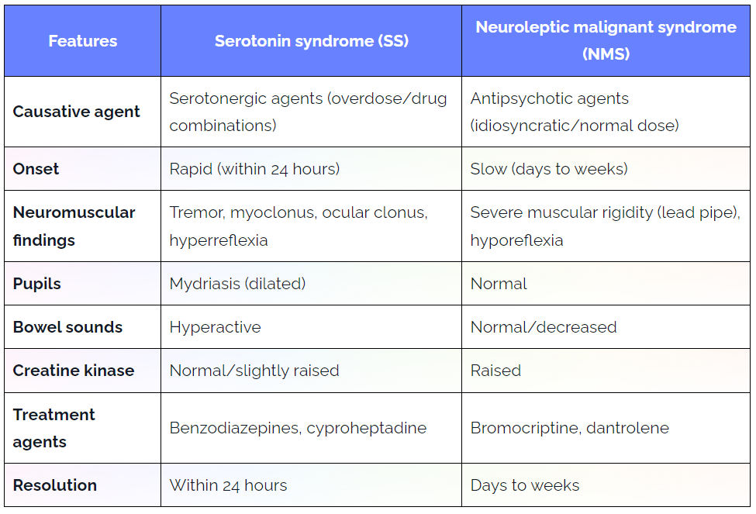
Serotonin Syndrome vs. NMS

Slide 19
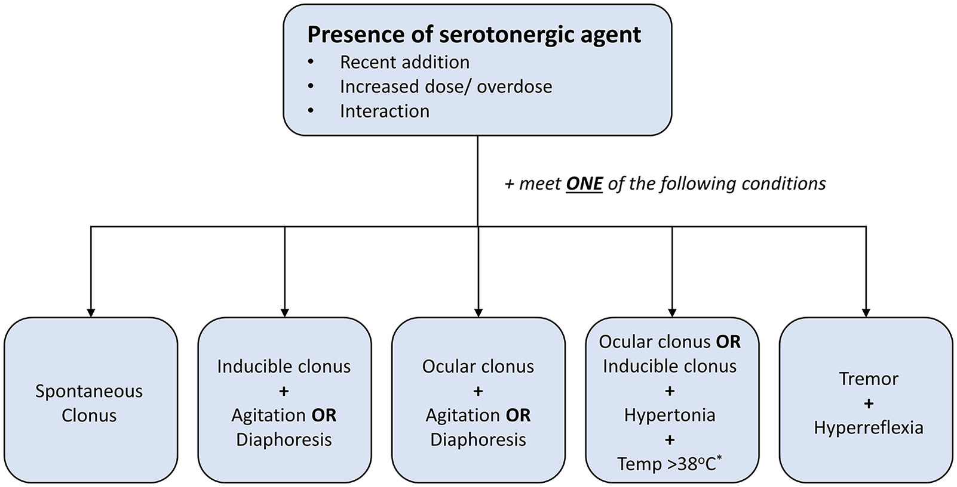
Serotonin Syndrome – Hunter Criteria
Highly underdiagnosed (clinical diagnosis)
  Hunter Criteria are 84% sensitive and 97% specific (better than original Sternbach criteria)
  Hunter Criteria were derived from overdose cases with single SSRI ingestion
  May not perform well in patients with concomitant neurologic dz, or patients with peripheral neuropathy
Scotton WJ, Hill LJ, Williams AC, Barnes NM. Serotonin Syndrome: Pathophysiology, Clinical Features, Management, and Potential Future Directions. International Journal of Tryptophan Research. 2019;12. doi:10.1177/1178646919873925

Slide 20
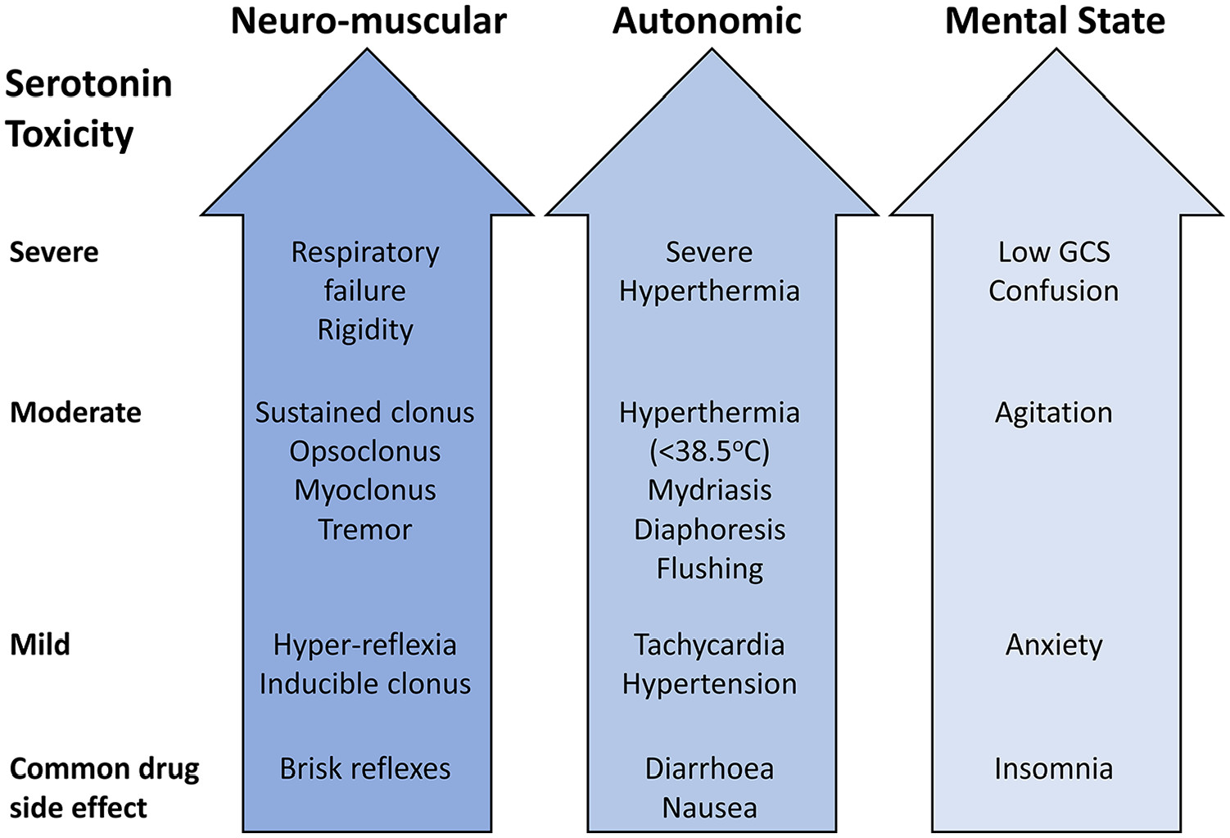
Serotonin Syndrome - Classification
Buckley NA, Dawson AH, Isbister GK. Serotonin syndrome. BMJ. 2014;348:g1626.

Slide 21
Serotonin Syndrome - Treatment
Withholding serotonergic medications
Supportive Care
Sedation for agitation
Administration of Serotonergic Antagonists
Prakash S, et al. Cyproheptadine in serotonin syndrome: A retrospective study. J Family Med Prim Care. 2024 Apr;13(4):1340-1346. doi: 10.4103/jfmpc.jfmpc_652_23.

Slide 22
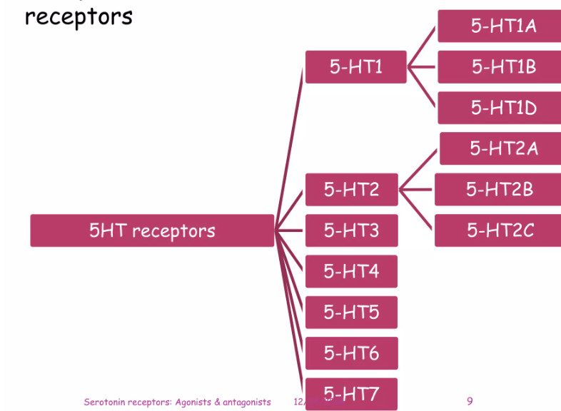
Cyproheptadine in Serotonin Syndrome
Limited evidence (case reports, retrospective studies)
Minimal evidence in overdose (severe SS)
  Best used in mild to moderate SS
Mechanism – blocks 5HT2A receptors

Slide 23
Cyproheptadine in Serotonin Syndrome
Author, Year | Methods | Results | Conclusion(s)
Prakash, et. al 2024 N = 23 Single-center | Retrospective review of 18yo with SS admitted for SS management Exclusion: DM, HTN Population: Mean age 35.2 y 52% female 10 ICU patients 13 Ward patients 48% on 2 serotonergic drugs 39% on 3 serotonergic drugs 57% had leukocytosis 39% had elevated CPK 91% had clonus ICU: 12mg cyproheptadine load, then 2mg q2h x 24h Ward: 4mg cyproheptadine tid | ICU: At 24 hours: 91% of patients had no or reduced clonus 73% of patients’ rigidity subsided 100% of ICU patients showed reduced degree of fever and diaphoresis 60% with AMS showed improvement After improvement cyproheptadine was withdrawn over 2 weeks Ward: At 24 hours: 100% of patients had improvement of clonus and other symptoms Duration of treatment 2-4 weeks. | Some response to cyproheptadine within 24h may be diagnostic of SS. Higher doses may be needed for acute treatment (12-32mg) in the first 24 hours. Limitations: varied dosing scheme. If tapered due to sedation and recrudescence of symptoms, resumed

Slide 24
Back to our patient….
Risk factors for SS:
  Sertraline alone
  Addition of Tramadol prn pain
  Addition of fluconazole (inhibits CYP2D6 – where sertraline is metabolized)
Moderate SS
  Cyproheptadine 4mg tid
  Symptoms resolved within 24 – 48 hours

Slide 25
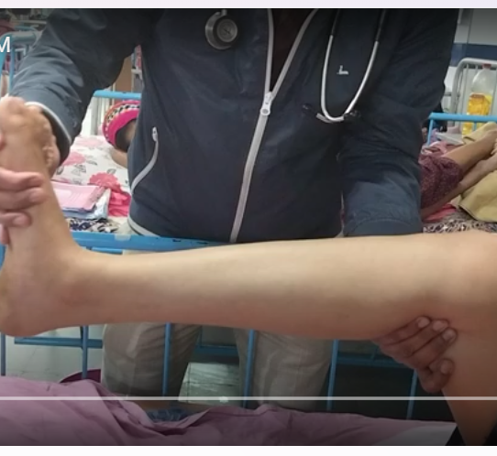
Clonus
Bing Videos

Slide 26

Patient Case
2 yo with AMS upon mother’s arrival at babysitter’s house
PE:
  Lethargy, unable to stand or walk normally
  Diaphoretic
  No sick contacts, not previously ill
  Moving all four extremities
  (-) tremor or rigidity
  Odd smell on clothing
Vitals:
  HR 115 : BP 90/palp : RR 20 : O2 sat 92%
  Pupils: 3-4 mm, sluggish

Slide 27
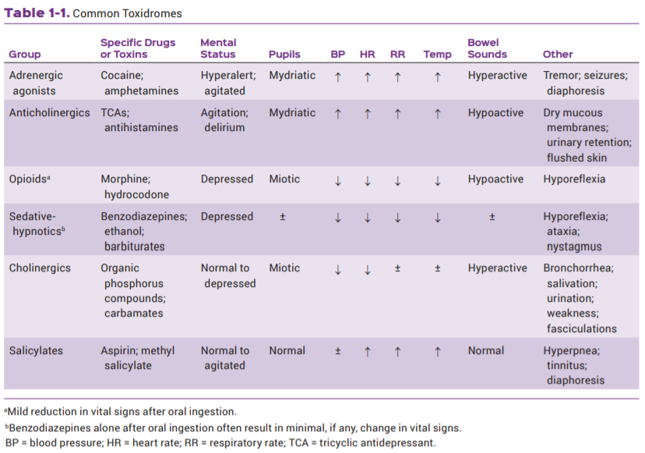
Common toxidromes: Pediatric

Slide 28
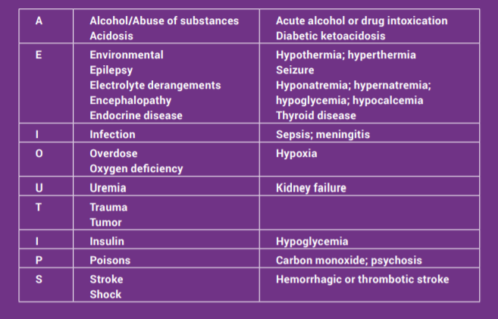
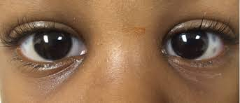
Toxidrome differential
Initial AEIOU TIPS assessment
  Apply oxygen
  Consider naloxone
    Pupil re-assessment – nystagmus noted
  Normal lung/bowel sounds
  Check blood sugar

Slide 29
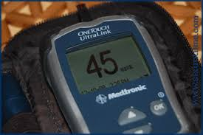
Toxidrome diagnosis
D10W bolus given with improvement in mental status
Ethanol level 100 mg/dL
CPS found vodka in a water bottle the child was accidentally given
Next steps
  Charcoal?
  Labs
  Supportive care

Slide 30
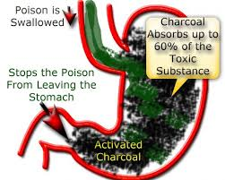
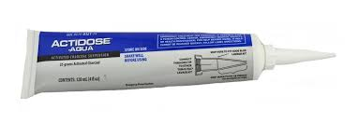
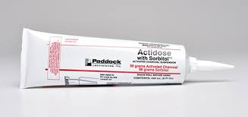
Charcoal
Consider for:
Ineffective in:
Oral ingestions
Known ingestions within 1H
Extended release tablets (XR, SR, LA, CD, XL, CR)
Peds: 1g/kg
Adults: 25g -100g
No evidence of improved outcomes
Vomiting patients
Altered patients
PHAILS
  Pesticides
  Hydrocarbons
  Acids (mineral)/alkalis (ammonia/bleach)/alcohols
  Iron
  Lithium
  Solvents
Chyka PA, et al. Position paper: single-dose activated charcoal. Clin Toxicol (Phila). 2005; 43(2):61-87.
Juurlink DN. Activated charcoal for acute overdose: a reappraisal. Brit J Clin Pharmacol. 2015; 81(3):482-7.

Slide 31
Toxicology Labs
APAP / Salicylate
Serum levels if indicated
  Rx drugs: digoxin, lithium, phenytoin, iron, primidone
  Environmental toxins: lead, mercury, carboxyhemoglobin
  Ethanol
Urine: UDS, U/A, Upreg
Blood gases (ABG, VBG), co-oximetry, capnography
Basic chemistries
Eldridge DL et al. Clin Lab Med. 2006; 26(1):13-30.
Thompson TM et al. Dis Mon. 2014; 60(11):509-24.

Slide 32
Key Lab findings
Anion Gap: Na – (Cl + HCO3)
  Elevated in MUDPILES / Decreased with lithium, iodide, polymixin B
Osmolal Gap: (2 x Na + (Glucose/18) + (BUN/2.8) + (Ethanol/4.6)
  Toxic alcohols
  Chemicals
    Ethyl ether, acetone, trichloroethane
  Drugs/additives
    INH
    Mannitol, glycerol
    Osmotic contrast dyes
Eldridge DL et al. Clin Lab Med. 2006; 26(1):13-30.
Mokhlesi B et al. Chest. 2003; 123(2):577-92.

Slide 33
Electrocardiogram Intervals
QRS widening
  NA channel blockade: TCAs, chloroquine, bupropion
QTc prolongation
  K efflux blockage: chlorpromazine, methadone, citalopram
T 40 ms axis deviation
  (> 120 degrees) in TCAs
  Sensitive for dysrhythmias & seizures
  Na Bicarb!
  https://www.resuscitationjournal.com/article/S0300-9572(11)00332-7/pdf
Yates C et al. Curr Cardiol Rev. 2012; 8(2):137-51.

Slide 34
Imaging
Abdominal films
  Time of ingestion
  Radiopaque material present
    Packers/stuffers, phenothiazines
    Iron/heavy metals
    Chloral hydrate
    Sustained release/enteric coating
CT
Ultrasound
Thompson TM et al. Dis Mon. 2014; 60(11):509-24.

Slide 35
Whole Bowel Irrigation
No evidence of improved outcomes
PEG solution (4 L product at RRMC)
Role: iron, lithium, body packers/stuffers, XR products
Limitations
  Requires patient stable enough for bedside commode
  Labor intensive
  Poor tolerance
    NG tube administration
    Emesis – stop and check tube placement
Thanacoody R et al. Clin Toxicol (Phila). 2015; 53(3):5-12.

Slide 36
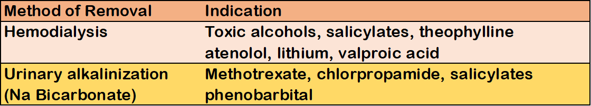
Key Antidotes
Principles of Hemodialysis:
Molecular weight <500 Da
VD < 1 L/kg
Low protein binding
High water solubility
Mokhlesi B et al. Chest. 2003; 123(2):577-92.
Marraffa JM et al. Am J Health-Syst Pharm. 2012; 69(3):199-212.

Slide 37
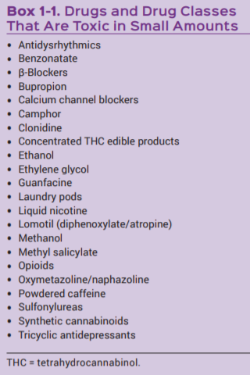
Deadly toxins
Narrow therapeutic window
One tablet can be fatal
  especially in pediatrics
Lack of available antidotes
Rapidly absorbed

Slide 38
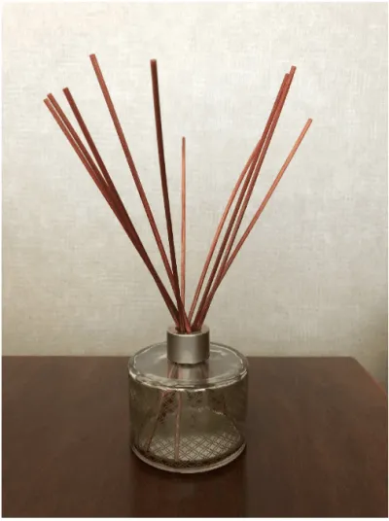
Patient Case
Called for 3 yo acting agitated with abdominal pain & drooling after ingestion of sweet smelling oil
Mother reports placing some essential ‘minty’ oil in the diffuser earlier today while cleaning
The canister was missing unknown amount
Timing of ingestion unknown

Slide 39
Toxidrome differential
Physical Exam
Ingestion differential
N/V
HR 160 / RR 65
BP 105/80
T 100.2
Lungs clear
Child pulling at ears
Camphor
Eucalyptus oil
Menthol
Oil of Wintergreen

Slide 40
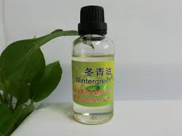
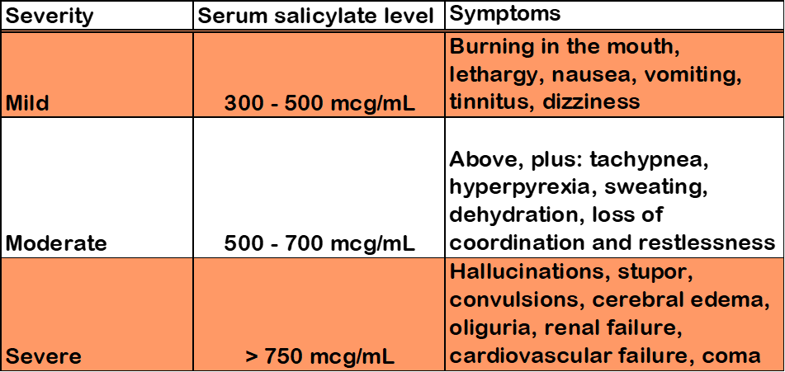
Toxidrome diagnosis
Sister texted a photo of the bottle to the mother while in the ambulance
  Wintergreen oil is 95-100% methyl salicylate
  1 teaspoon can be deadly in a toddler
  Rapid and complete
  absorption
    Charcoal ineffective

Slide 41
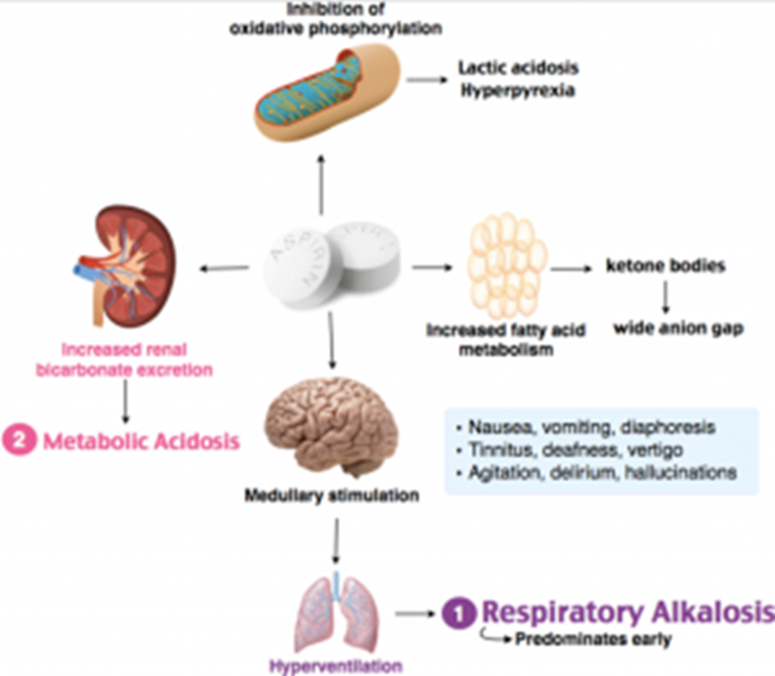
Toxidrome diagnosis
Hang fluids
1 mEq/kg Sodium Bicarbonate IV push
ABG and serum salicylate level
  Found to be 550 mcg/mL
  Sodium Bicarbonate / potassium infusion initiated to alkalinize the urine
Monitor:
  BG / Urine output / K+ / neuro status
  Serial salicylate levels
  If symptoms progress, consider dialysis
Notes:
Salicylates uncouple oxidative phosphorylation intracellularly limit production of ATP, and increase lactate production, leading to ketosis and a wide anion-gap metabolic acidosis • Salicylates stimulate the respiratory center, leading to hyperventilation and respiratory alkalosis

Slide 42
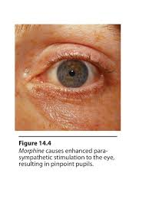
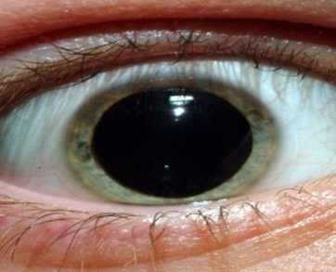

Illicit toxidromes
Stimulants:
Sedatives:
Hallucinogens:
Dilated pupils
Hyperpyrexia
Tachycardia
Hypertension
Convulsions
Cardiac arrest
ICH
Stroke
Altered mental status
Lack of coordination
Pupils sluggish or pinpoint
Respiratory depression
Nystagmus
Seizures
Dilated pupils
Hyperpyrexia
Tachycardia
Altered mental status
Bad trip
Syncope
Vomiting

Slide 43
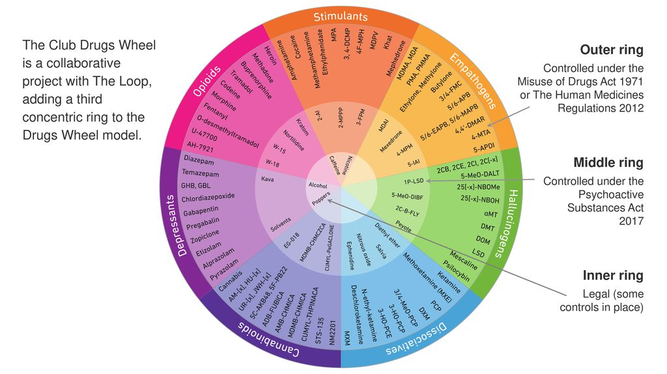

Slide 44
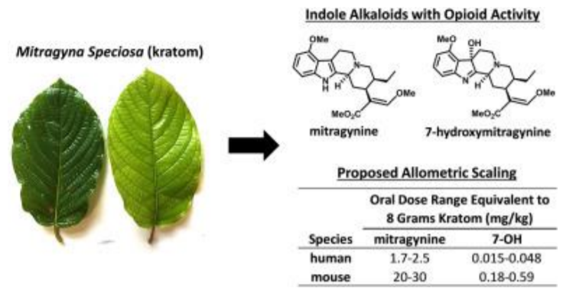
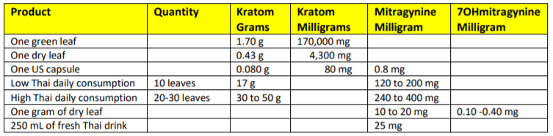
Emerging substance: Kratom
Mu-opioid receptor agonist
“alternative” for chronic pain
Adrenergic agonist
Calcium channel blocker
NMDA receptor agonist
5HT2-A receptor agonist
Skeletal muscle relaxant
Lipophilic
24H half-life
High volume of distribution

Slide 45
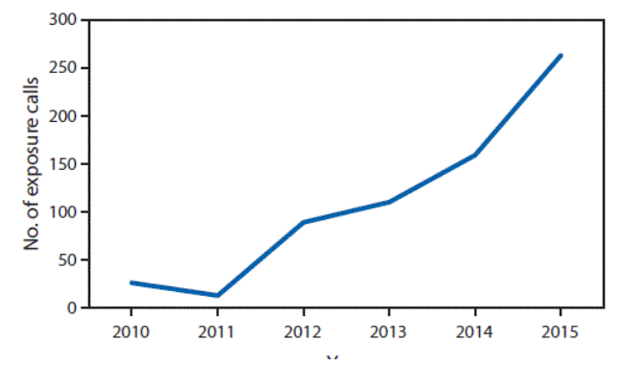
Emerging substance: Kratom
DEA lists this substance as a drug of concern, however not illegal in U.S.
Illegal in U.K.
Higher risk of death in combination with other substances
Highest risk in adults
Kratom alone does not remove respiratory drive
Most deadly toxicities are due to cardiovascular collapse
  Naloxone
  Case report of intralipid rescue
Number of exposure calls to poison control 2010 – 2015 in U.S.

Slide 46
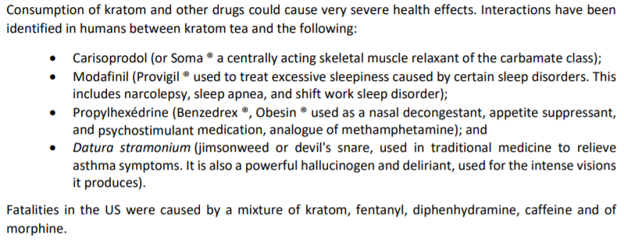
Emerging substance: Kratom
Anwar M, Law R, Schier J. Notes from the Field. Kratom (Mitragyna speciosa) Exposures Reported to Poison Centers — United States, 2010–2015. MMWR Morb Mortal Wkly Rep 2016;65:748–749.

Slide 47
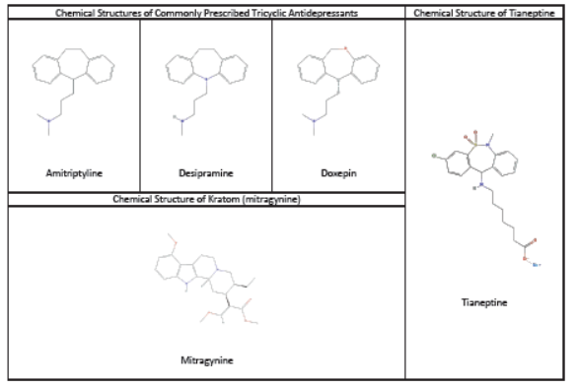
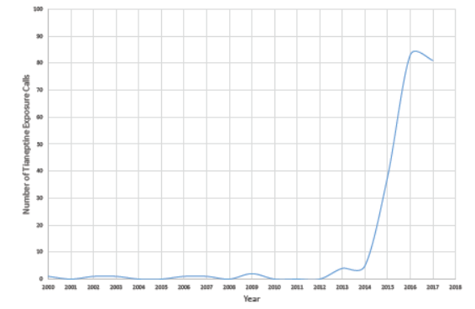
Emerging Substance: Tianeptine
1700% increase in exposure calls

Slide 48
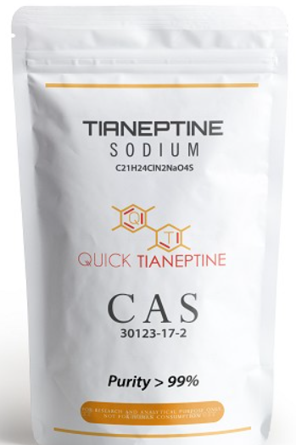
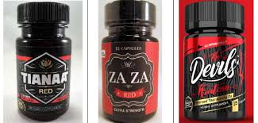
Emerging Substance: tianeptine
Prescription drug in Europe and Latin America
  Stablon®, Coaxil®, Tatinol®
Tricyclic – or is it?
Regulates glutamate receptors
  Acts on NMDA / AMPA receptors
Mu-opioid / delta opioid receptor agonist
Inconsistent purity / potency
Ability to combine with other agents
Ingested / smoked / injected
Kinetics:
  95% protein bound
  High volume of distribution
  99% bioavailability
  Half-life 2.5 H
  Renal clearance
Neurologic / cardiovascular / GI symptoms
Stabilized by naloxone / naloxone infusions
Springer J, Cubala WJ. J Psychoactive Drugs. 2018;50(3):275-280.
Bakota EL, Samms WC, Gray TR, et al. J Anal Toxicol. 2019;43(2):e1.

Slide 49
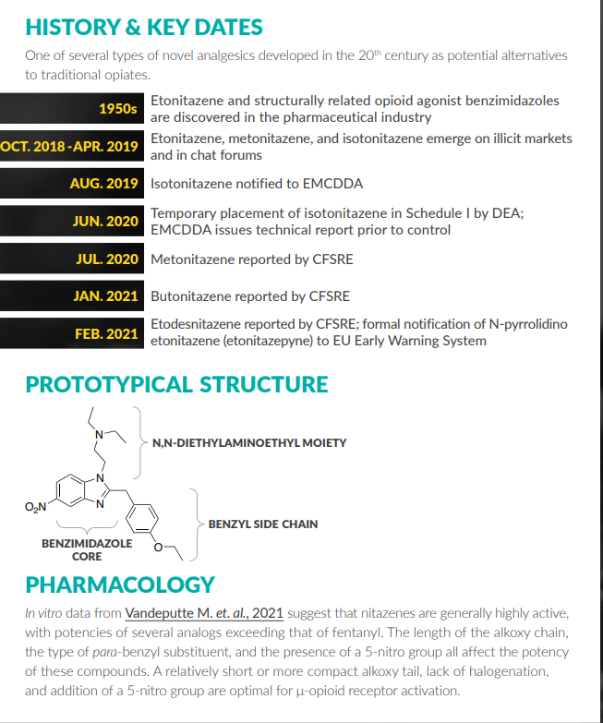
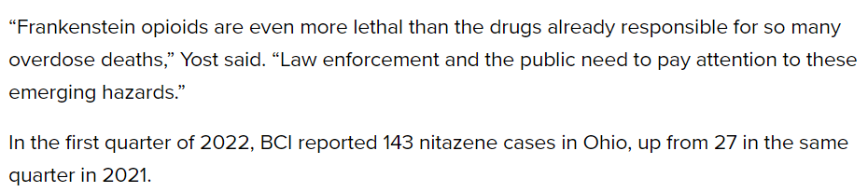
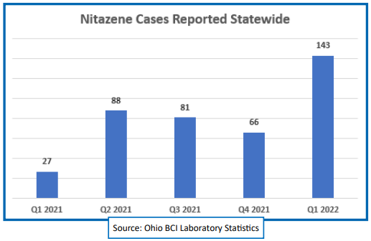
Emerging Substance:
Nitazene

Slide 50
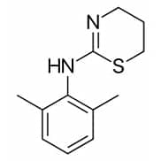
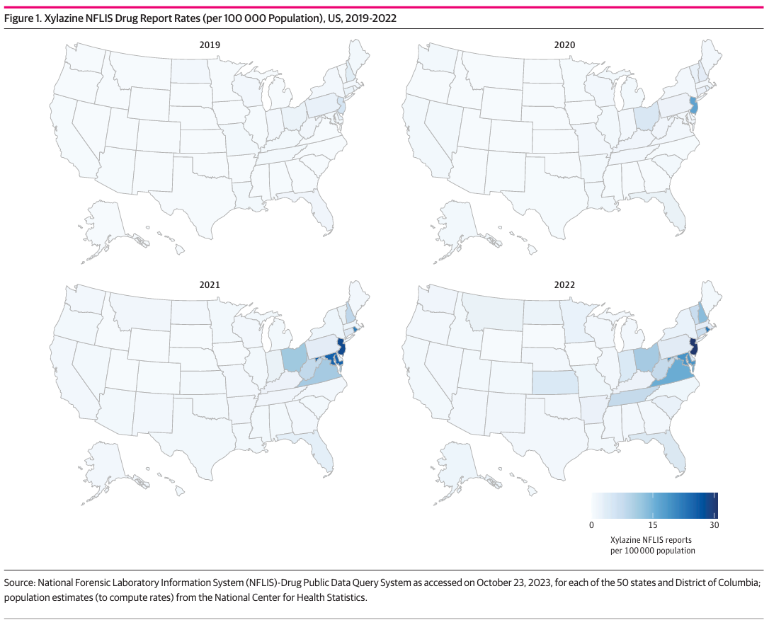
Emerging Substance: Xylazine
Veterinary tranquilizer
  Clonidine analogue
Does not respond to naloxone
  Co-injected with fentanyl
Severe tissue necrosis at injection sites
Cano M, Daniulaityte R, Marsiglia F. Xylazine in Overdose Deaths and Forensic Drug Reports in US States, 2019-2022. JAMA Netw Open. 2024;7(1):e2350630. doi:10.1001/jamanetworkopen.2023.50630

Slide 51
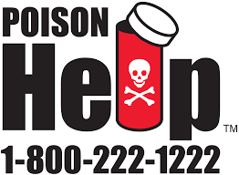
Summary
Medic/ER reports helpful
Be a detective!
  Perform in-depth ingestion & medication history
Toxidromes are key to ingestion treatment
Learn the antidotes
Key resources:
  Poison control center
  DEA annual drug threat assessment
  Drug take back events
  Drug wheel

Slide 52
References
Thompson TM, Theobald J, Lu J, Erickson TB. The general approach to the poisoned patient. Dis Mon. 2014 Nov;60(11):509-24. doi: 10.1016/j.disamonth.2014.10.002. Epub 2014 Nov 7. PMID: 25454682.
Prakash S, Patel H, Kumar S, Shah CS. Cyproheptadine in serotonin syndrome: A retrospective study. J Family Med Prim Care. 2024 Apr;13(4):1340-1346. doi: 10.4103/jfmpc.jfmpc_652_23. Epub 2024 Apr 22. PMID: 38827706; PMCID: PMC11142004.
Scotton WJ, Hill LJ, Williams AC, Barnes NM. Serotonin Syndrome: Pathophysiology, Clinical Features, Management, and Potential Future Directions. International Journal of Tryptophan Research. 2019;12. doi:10.1177/1178646919873925
Chyka PA, Seger D, Krenzelok EP et al. Position paper: single-dose activated charcoal. Clin Toxicol (Phila). 2005; 43(2):61-87.
Juurlink DN. Activated charcoal for acute overdose: a reappraisal. Brit J Clin Pharmacol. 2015; 81(3):482-7.
American Academy of Clinical Toxicology & European Association of Poisons Centres and Clinical Toxicologists. Position paper: cathartics. J Toxicol Clin Toxicol. 2004; 42(2):243-53.
American Academy of Clinical Toxicology & European Association of Poisons Centres and Clinical Toxicologists. Position statement and practice guidelines on the use of multi-dose activated charcoal in the treatment of acute poisoning. J Toxicol Clin Toxicol. 1999; 37(6):731-51.
Eldridge DL, Holstege CP. Utilizing the laboratory in the poisoned patient. Clin Lab Med. 2006; 26(1):13-30.
Marraffa JM, Cohen V, Howland MA. Antidotes for toxicological emergencies: a practical review. Am J Health-Syst Pharm. 2012; 69(3):199-212.
Mokhlesi B, Leiken JB, Murray P, Corbridge, TC. Adult toxicology in critical care: part I: general approach to the intoxicated patient. Chest. 2003; 123(2):577-92.
Olson KR, Pentel PR, Kelley MT. Physical assessment and differential diagnosis of the poisoned patient. Med Toxicol. 1987; 2(1):52-81.
Thanacoody R, Caravati EM, Troutman B et al. Position paper update: whole bowel irrigation for gastrointestinal decontamination of overdose patients. Clin Toxicol (Phila). 2015; 53(3):5-12.
Yates C, Manini AF. Utility of the electrocardiogram in drug overdose and poisoning: theoretical considerations and clinical implications. Curr Cardiol Rev. 2012; 8(2):137-51.

Slide 53
Murphy, Paul. Skills station: Drug overdose considerations. https://www.emsworld.com/article/10319335/skills-station-drug-overdose-considerations. Accessed Oct 27, 2020.
Santos C, Olmedo R. Sedative-Hypnotic Drug Withdrawal Syndrome: Recognition and Treatment. Emergency Medicine Practice Guidelines. Evidence Based Medicine Journal. March 2017;19(7):1-20
Curry S, et al. Chapter 14: Neurotransmitters and Neuromodulators. Chapter in Goldfrank’s Toxicologic Emergencies, 10th edition. New York: McGraw-Hill Education, 2015, p173-201
Burns MJ, Linden CH, Graudins A et al. A comparison of physostigmine and benzodiazepines for the treatment of anticholinergic poisoning. Ann Emerg Med. 2000;35:374-81.
Rasimas JJ, Sachdeva KK, Donovan JW. Revival of an antidote: bedside experience with physostigmine. J Amer Acad Emerg Psychiatr. 2014;12:5–24.
Suchard JR: Assessing physostigmine’s contraindication in cyclic antidepressant ingestions. J Emerg Med. 2003; 25:185-91.
Soulaidopoulos S, Sinakos E, Dimopoulou D, Vettas C, Cholongitas E, Garyfallos A. Anticholinergic syndrome induced by toxic plants. World J Emerg Med. 2017;8(4):297-301. doi:10.5847/wjem.j.1920-8642.2017.04.009
Isbister GK, Kumar VVP. Indications for single-dose activated charcoal administration in acute overdose. Curr Opin Crit Care 2011;17:351-7.
Marraffa, J. PedSAP 2017: Pediatric Emergencies: Toxicology Overview. ACCP 2017 Book
Dargan PI, Wallace CI, Jones AL. An evidence based flowchart to guide the management of acute salicylate (aspirin) overdose. Emergency Medicine Journal 2002;19:206-209.
Mark Adley. The Drug wheel: A new model for substance awareness. http://www.thedrugswheel.com/ Developed 2012. Accessed Nov 3, 2020.
American Drug Foundation. https://adf.org.au/drug-facts/#wheel Oct 24, 2019. Accessed Nov 1, 2020.
Buckley NA, Dawson AH, Isbister GK. Serotonin syndrome. BMJ. 2014;348:g1626.
Cano M, Daniulaityte R, Marsiglia F. Xylazine in Overdose Deaths and Forensic Drug Reports in US States, 2019-2022. JAMA Netw Open. 2024;7(1):e2350630. doi:10.1001/jamanetworkopen.2023.50630

Slide 54
Aggarwal G, Robertson E, McKinlay J, Walter E. Death from Kratom toxicity and the possible role of intralipid. J Intensive Care Soc. 2018;19(1):61-63. doi:10.1177/1751143717712652
Gassaway MM, Rives ML, Kruegel AC, et al. The atypical antidepressant and neurorestorative agent tianeptine is a mu-opioid receptor agonist. Transl Psychiatry. 2014;4:e411
El Zahran T, Schier J, Glidden E, et al. Characteristics of tianeptine exposures reported to the National Poison Data System-United States, 2000-2017. MMWR Morb Mortal Wkly Rep. 2018;67(30):815-818.
Springer J, Cubala WJ. Tianeptine abuse and dependence in psychiatric patients: a review of 18 case reports in the literature. J Psychoactive Drugs. 2018;50(3):275-280.
Bakota EL, Samms WC, Gray TR, et al. Corrigendum to “Case reports of fatalities involving tianeptine in the United States.” J Anal Toxicol. 2019;43(2):e1.
Tianeptine. https://go.drugbank.com/drugs/DB09289. Accessed Nov 1, 2020.
2019 NSDUH. https://www.samhsa.gov/data/
Hogland, J. Kopeland, K. ACMT Visual pearls in toxicology. May 2020. https://www.acmt.net/ Accessed Oct 28, 2020.
Kopeland K. Hayes B. https://www.aliem.com/acmt-toxicology-visual-pearls-toxic-weed/
http://www.emdocs.net/toxcards-sympathomimetic-vs-anticholinergic-toxidromes/
Swamintham, A. Salicylate Toxicity. Written May 2018. https://rebelem.com/salicylate-toxicity/ Accessed Nov 1, 2020.
Villa, Lauren. Kratom Overdose. https://drugabuse.com/kratom/overdose/ Written Sept 5, 2019. Accessed Nov 3, 2020.
Anwar M, Law R, Schier J. Notes from the Field. Kratom (Mitragyna speciosa) Exposures Reported to Poison Centers — United States, 2010–2015. MMWR Morb Mortal Wkly Rep 2016;65:748–749. DOI: http://dx.doi.org/10.15585/mmwr.mm6529a4
Ratard, Raoult. Kratom Study on the public health risks and recommendations. Louisiana office of public health, February 2019. https://ldh.la.gov/assets/docs/LegisReports/HR177RS2018219.pdf
https://www.acep.org/tox/sim-cases.html

Slide 55
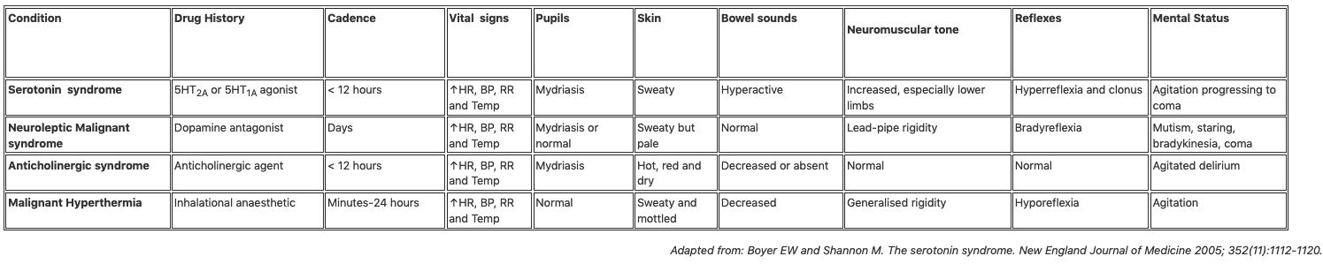
Differentiation of Serotonin vs. other syndromes

Slide 56
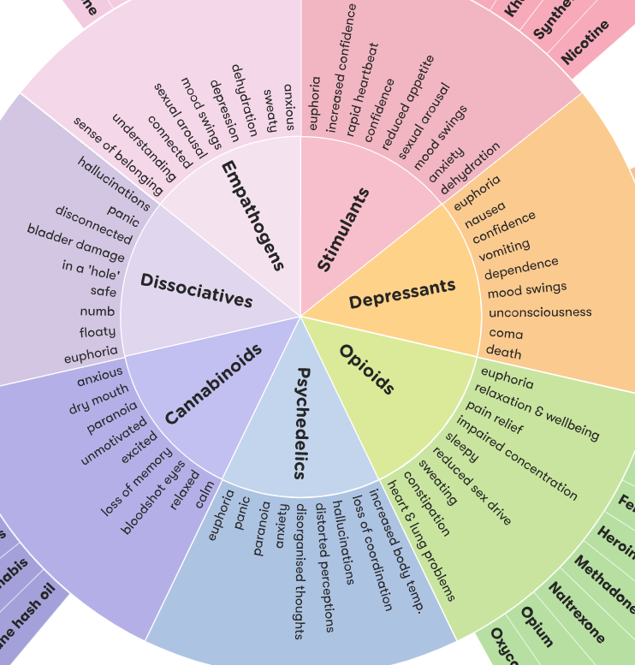
Toxidromes
Withdrawal can cause reverse symptoms with most agents
Withdrawal can range from a bad flu to seizures, coma and death
Alcohol withdrawal can be fatal

