Slide 1
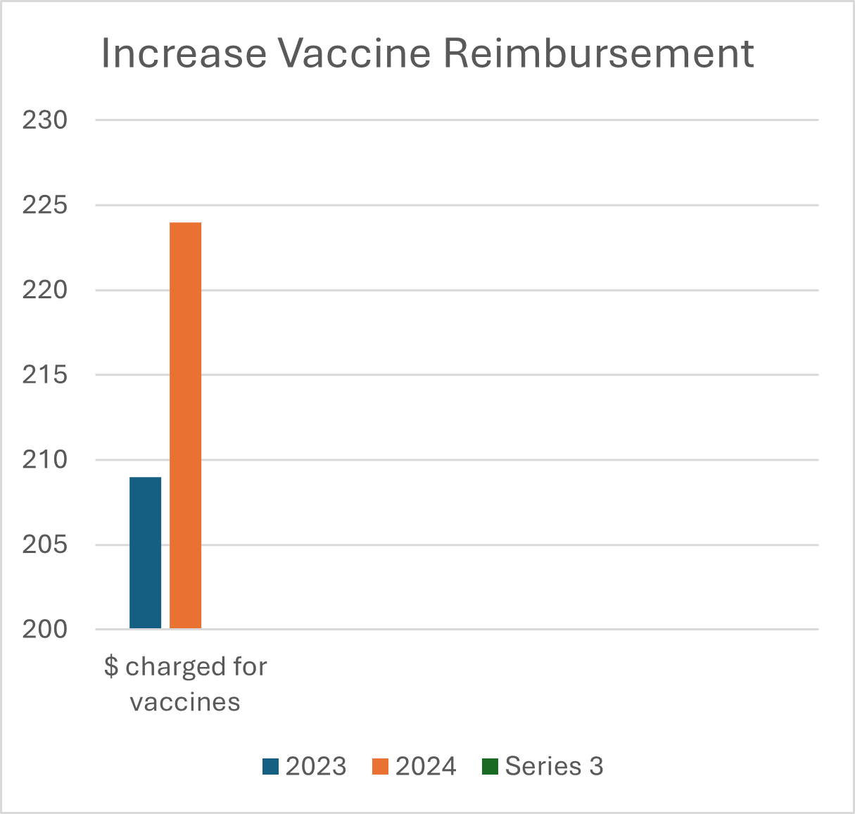
Riverside Primary Care Mercury West
Maximize Reimbursement for What we “Already Do”
P. Pennyfeather, DNP, CPNP and Savannah Forrest, LPN
Doctoral Council
Vaccine financing and coding. (n.d.). https://www.aap.org/en/practice-management/practice-financing/coding-and-valuation/vaccine-financing-and-coding/
Vaccine financing and coding. (n.d.). https://www.aap.org/en/practice-management/practice-financing/coding-and-valuation/vaccine-financing-and-coding/
Problem Statement
Plan
Post-Intervention Data
Implications
I attended an American Academy of Pediatrics conference in Oct of 2023 and learned about proper documentation and the importance of billing for each individual component of vaccines to maximize reimbursement. I had previously observed that providers seeing pediatric patients in our office routinely counseled patients on recommended vaccines during visits but were not documenting the counseling or billing appropriately. The time needed to properly educate patients is vital to the exam, yet we were not being reimbursed for this time.
Additionally, billing and coding personnel were not aware that vaccines containing multiple components should be billed separately to obtain full reimbursement.
For example:
Adacel or Boosterix brand names should be billed Tetanus, diphtheria toxoids and acellular pertussis vaccine (3 components)
MMR II should be billed for measles, mumps, & rubella (3 components)
(Proquad) should be billed for measles, mumps, rubella, & varicella (4 components)
It was my desire that any provider administering these vaccines use appropriate counseling lingo within their note and that their billing team was billing for each component of vaccines separately.
Our first step was to have a discussion with our office manager and other providers to determine what we were currently billing for vaccines.
Met with my nurse to begin reviewing charts from the previous months and noted that our biller was not billing for each component of vaccines nor crediting providers with counseling time.
Purchased a pediatric billing and coding book to make dot phrases which met criteria for billing.
My nurse researched each vaccine that we administered and outlined each component of the vaccine.
Scheduled a Zoom meeting to discuss findings with our billing staff.
We determined which codes needed changing and agreed on dot phrases that indicated counseling on vaccines.
Meet with billing team to ensure appropriate billing moving forward.
Disseminated this vaccine reimbursement information to colleagues' system wide
Create appropriate dot phrases to be used by providers when documenting vaccine counseling and education
Hardwire this into practice ensuring that all new providers are aware of this billing improvement
After using appropriate vaccine codes and billing for individual components of the vaccine we found increased revenue as noted below:
Total vaccine charges from January through November in 2024 were $224,190.39.
Vaccine charges increased by 7% which amounted to an additional $14,756.23 of billable dollars
The average charge per vaccine also increased by $18.20 at each visit
We also realized a 13.2% increase in payments from billing changes which brought in an additional $10,496.52 to the practice
.
References
Vaccine financing and coding. (n.d.). https://www.aap.org/en/practice-management/practice-financing/coding-and-valuation/vaccine-financing-and-coding/
PEDIARIX [Diphtheria and tetanus toxoids and acellular pertussis adsorbed, hepatitis B (Recombinant) and inactivated poliovirus vaccine] Coding Info | GSKPro. (n.d.). https://gskpro.com/en-us/therapy-areas/vaccines/coding/gsk-vaccines/pediarix/
CPT codes for ProQuad® (Measles, Mumps, Rubella and Varicella Virus Vaccine Live). (2024, November 15). Proquad-mv. https://www.merckvaccines.com/proquad/cpt-codes/
Conclusions
Documenting face to face counseling and billing for individual components of vaccines improved vaccine charge rates within the practice.
Vaccine charges increased by $14,756.23 in 2024 - a 7% increase over 2023.
The average charge per vaccine increased by $18.20 in 2024 – an increase of 10.4%.
Not only is this valuable information for the pediatric offices but it is also applicable to family practice, women’s health, obstetrics and virtually all offices that provide vaccines
PICOT Question
Pre-intervention Data
How will adding patient education and counseling codes to outpatient billing for vaccines affect reimbursement?
Pre-intervention data was collected to look at vaccine reimbursement charges from January 2023 through November 2024.
Total vaccine charges for that year were $209,434.16
During that same year, the average payment on an office visit with vaccines was $175.79
Contact Information
Patrice L Pennyfeather, DNP, CPNP
Primary Care Mercury West
757-827-1940
Patrice.Pennyfeather@rivhs.com

